Slide 1
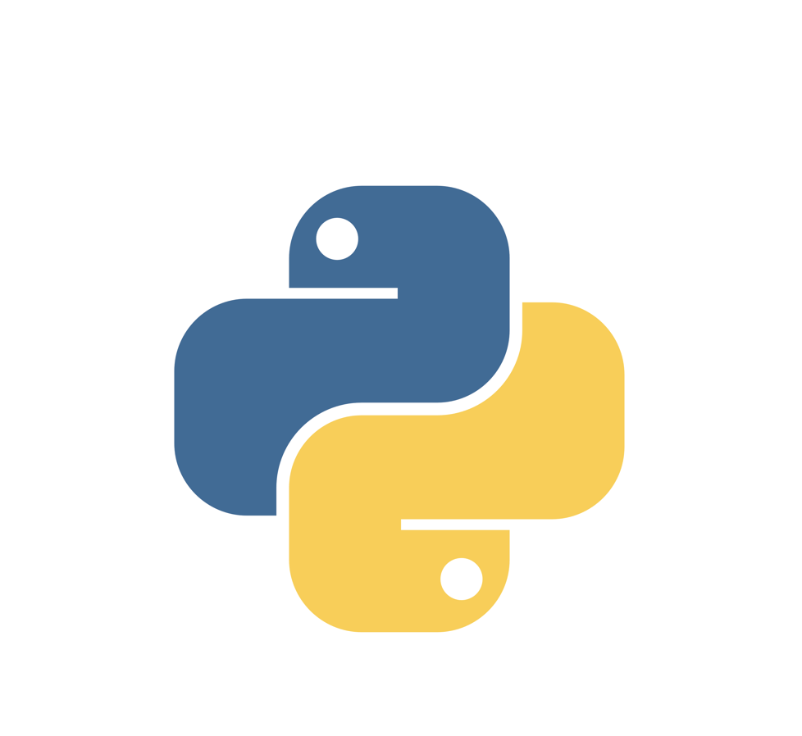
Chapter 2
VARIABLES, EXPRESSIONS, AND STATEMENTS

Slide 2
2.1 Values and types
A value is one of the basic things a program works with and this can be letter or a number.
Values have different types: 1, 2, 3 are integers , and a string is “Hello, World!”. We called it string because it contains a “string” of letters. The interpreter can identify strings because they are enclosed in quotation marks.
We use print statement for string and also for integer.

Slide 3
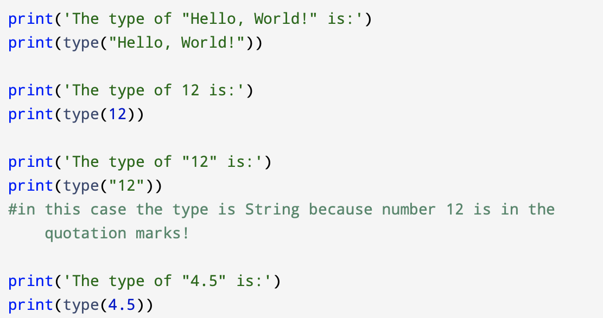
You can always check what type a value has:

Slide 4
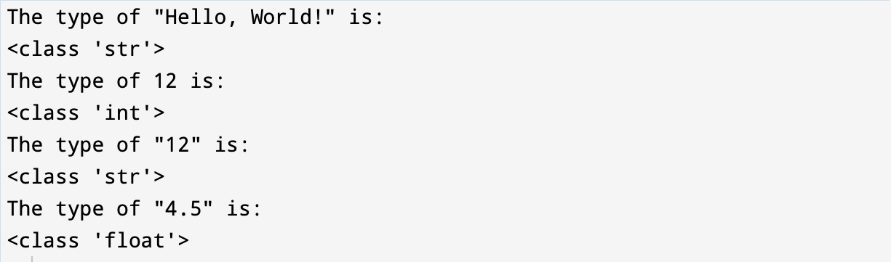
Output:

Slide 5
When you type large integer and you use commas between of three digits like in 1,000,000.
Python interprets 1,000,000 as a comma separated sequence of integers, which it prints with spaces between
Output:
This is the example of a semantic error: the code runs without producing an error message, but it doesn’t do the “right” thing.

Slide 6
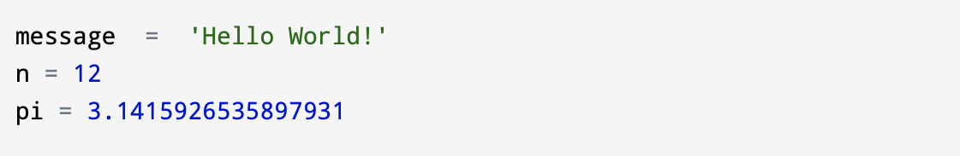
2.2 Variables
A variable is a name that is used to represent a value that can change when a program is run.
An assignment statement creates new variables and gives them values:
The example above show us three assignments. The first assigns a string to a new variable named message; the second assigns the integer 12 to n; the third assigns value of π to pi.

Slide 7
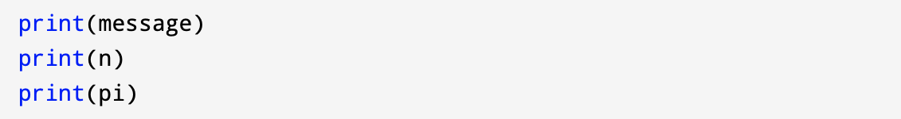
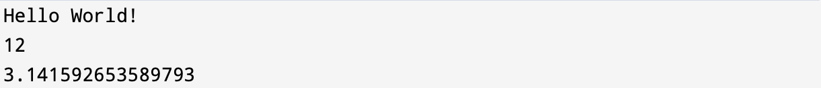
To display the value of a variable, you can use a print statement:
Output:

Slide 8
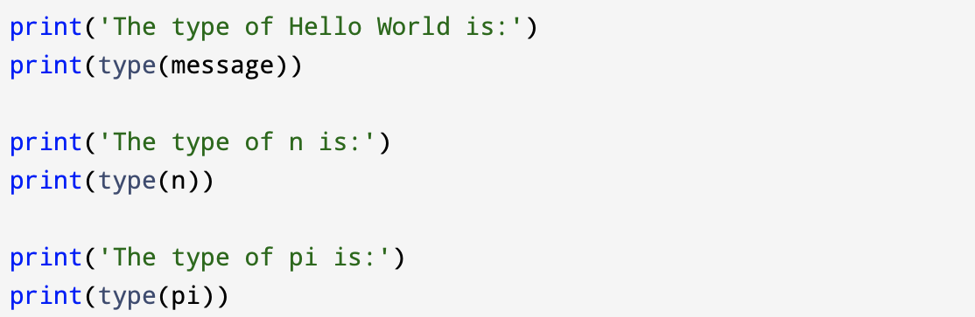
The type of a variable is the type of the value it refers to.

Slide 9
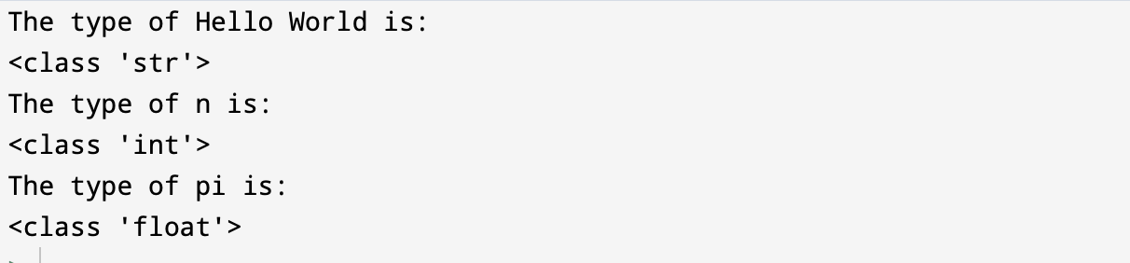
Output:

Slide 10
2.3 Variable names and keywords
Programmers choose names for their variables that are meaningful and document what the variable is used for.
Variable names:
can be arbitrarily long,
can contain both letters and numbers,
it is legal to use uppercase letters, but it is a good idea to begin variable names with a lowercase letter,
cannot start with a number.

Slide 11
( _ ) the underscore character can appear in a name. It is used in names with multiple words, such as my_name.
variable names can start with an underscore character, but we generally avoid doing this unless we are writing library code for others to use.
separate words with ‘camelCase’ notation. Use upper case letters to signify word boundaries.

Slide 12
If you give a variable an illegal name, you get a syntax error:
80grade = 'Hello World!'
world# = 1000000
class = 'Computer Science 101’
80grade is illegal because it begins with a number.
World# is illegal because it contains an illegal character, #.
Class is illegal because it contains one of Python’s keywords. (The interpreter uses keywords to recognize the structure of the program, and they cannot be used as variable names.)

Slide 13
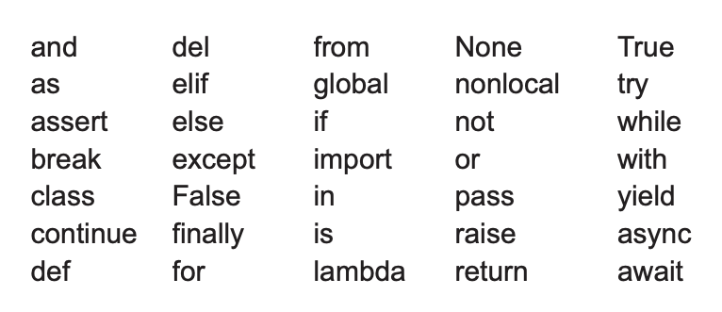
Python reserves 35 keywords:

Slide 14
2.4 Statements
A statement is a unit of code that the Python interpreter can execute.
We have seen two kinds of statements:
expression statement (print)
assignment statement
If a script contains more than one statement, the results appear as the statements execute.

Slide 15
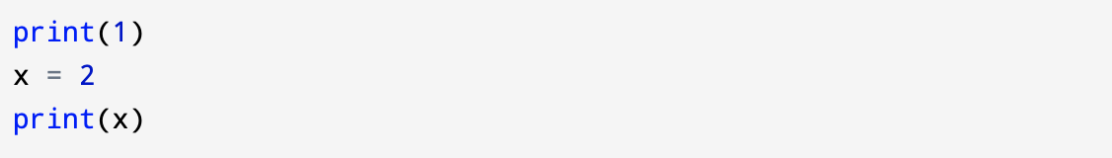
For example, this script produces the following output:
Output:

Slide 16
2.5 Operators and operands
Operators are symbols used to represent computations. Operators are applied to values referred to as operands.
The values the operator is applied to are called operands. For example, in the expression 20 - 5, the operator is - , and the values 20 and 5 are operands.
Python uses + and - and parentheses (for grouping) in the same way they are used in arithmetic.
Multiplication, division, and exponentiation use *, /, and **, respectively. So 3 * 4 is “three times four” and 3 ** 4 is “three raised to the fourth power” or 3⁴.

Slide 17
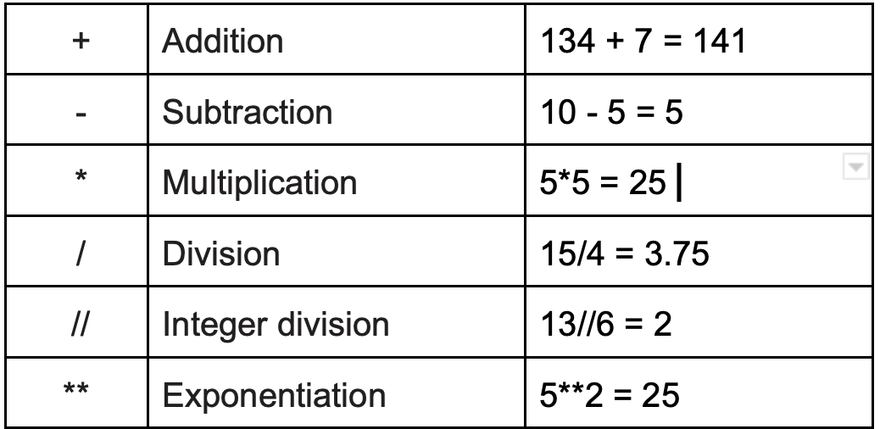
Operators:

Slide 18
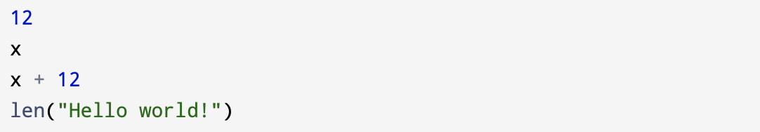
2.6 Expressions
Expressions are values, variables, operators, and function calls.
Example:
If you type an expression in interactive mode, the interpreter evaluates it and displays the result:

Slide 19
Output:
In a script, an expression all by itself doesn’t do anything! This is a common source of confusion for beginners.

Slide 20
2.7 Order of operations
For mathematical operators, Python follows mathematical convention. The acronym PEMDAS is a useful way to remember the rules:
Parentheses
Exponents
Multiplication/ Division (in order that they appear)
Addition/ Subtraction (in order that they appear)
Examples:
2 * (3-1) is 4
3*1**3 is 3, not 27
6+4/2 is 8, not 5
Remember to always put parentheses in your expressions to make sure the computations are performed in the order you want.

Slide 21
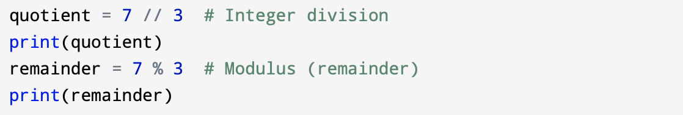
2.8 Modulus operator
The modulus operator (%) works on integers and yields the remainder when the first operand is divided by the second. In Python, the modulus operator is a percent sign (%).
Example above shows that 7 divided by 3 is 2 (the quotient) with 1 left over (the remainder).

Slide 22
The modulus operator turns out to be surprisingly useful.
For example:
You can check whether one number is divisible by another: if x % y is zero, then x is divisible by y.
You can also extract the right-most digit from a number. For example, x % 10 yields the right-most digit of x (in base 10).

Slide 23
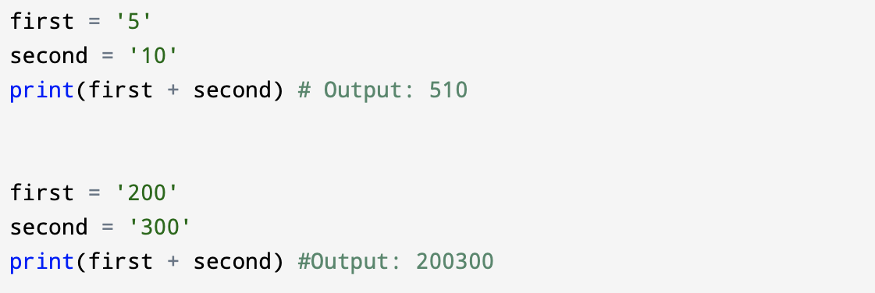
2.9 String operations
The + operator works with strings, but it performs concatenation, which means joining the strings by linking them end to end.
For example:

Slide 24
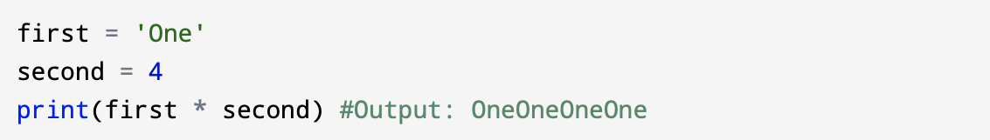
The * operator also works with strings by multiplying the content of a string by an integer.
For example:

Slide 25
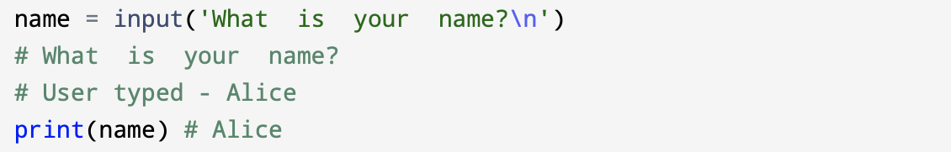
2.10 Asking the user for input
Python provides a built-in function called input that gets input from the keyboard.
When this function is called, the program stops and waits for the user to type something and return.
The sequence ‘\n’ on the end of the prompt creates a newline.

Slide 26
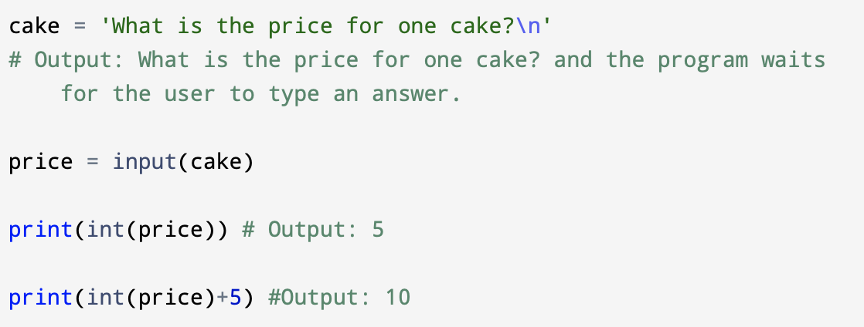
It is important to remember that input() function returns value as a string.
If you want to use result as a number in your program, you have to convert it into the appropriate type using the int() or float().
If the user types something other than a string of digits, you’ll receive an error.

Slide 27
2.11 Comments
When programs get bigger and more complicated, that can be more difficult to read.
Programming languages are dense, and it is difficult to look at a piece of code and figure out what it is doing, or why.
That's why it is a good idea to add notes to your code to explain in natural language what the program is doing.
Those types of notes are called comments, and in Python they start with the # symbol.

Slide 28
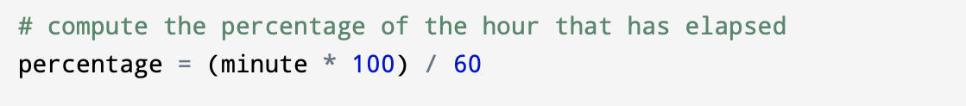
In the example below, the comment appears on a separate line above.
Also, you can put comments at the end of a line:
Everything from the # to the end of the line is ignored by the computer so it has no effect on the program.

Slide 29
Comments are most useful when they document non-obvious features of the code.
In most cases, the reader can figure out what the code does but comments helps explain why.
We don't have to comment every line of the code or piece of code that is obvious. Comment in the example below is redundant and useless:
Comment in that case contains useful information that is not in the code:

Slide 30
It is important to give good (meaningful) variable names so we can reduce the need for comments. But on the other hand long names can make complex expressions difficult to read, so there is a trade-off.

Slide 31
2.12 Choosing mnemonic variable names
You have a lot of choice when you name your variables, as long as you follow the simple rules of variable naming and avoid keywords.
In the beginning, this choice can be difficult/confusing both when you read a program and when you write your own programs.
For example, below you have three programs are identical in terms of what they accomplish, but different when you read them and try to understand them.

Slide 32
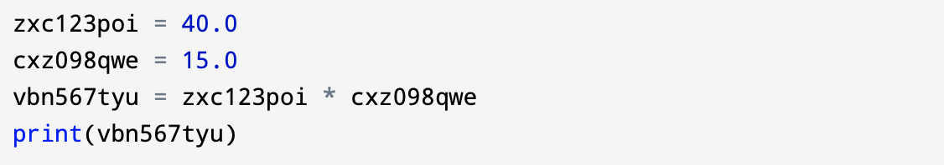
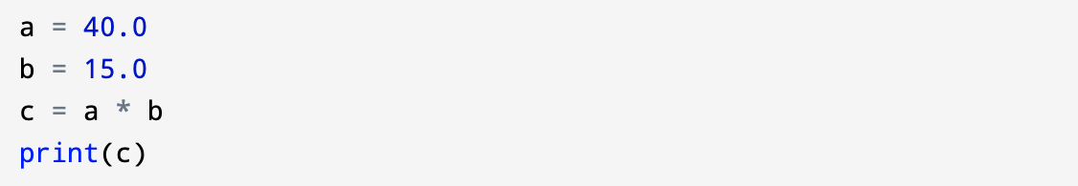
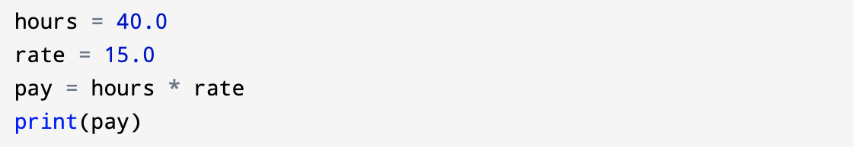

Slide 33
The Python interpreter sees all three of these programs as exactly the same but humans see and understand these programs quite differently. Humans will most quickly understand the intent of the third program because the programmer has chosen variable names that reflect their intent regarding what data will be stored in each variable.

Slide 34
Wisely chosen variable names we call: “mnemonic variable names.”
The word mnemonic means "memory aid". We choose mnemonic variable names to help us remember why we created the variable in the first place.
Sometimes, mnemonic variables can be hard to parse and understand code for beginning programmers.
This is because beginning programmer's have not yet remembered the python keywords and in some cases chosen names are too descriptive and they look like part of the language and not well-chosen variable names.

